Slide 1
Building custom Target object tracking using SOTA

Slide 2
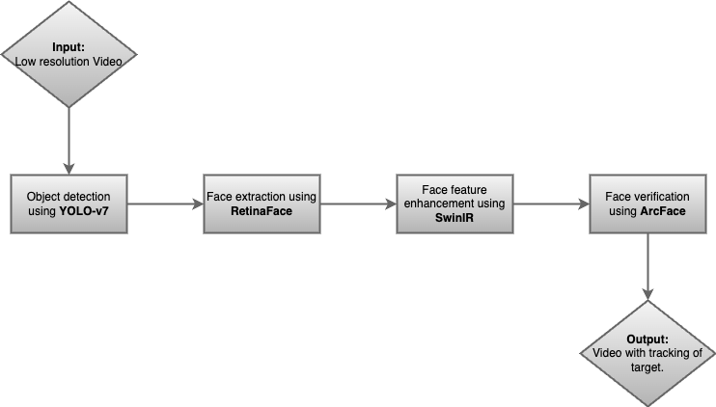
Pipeline

Slide 3
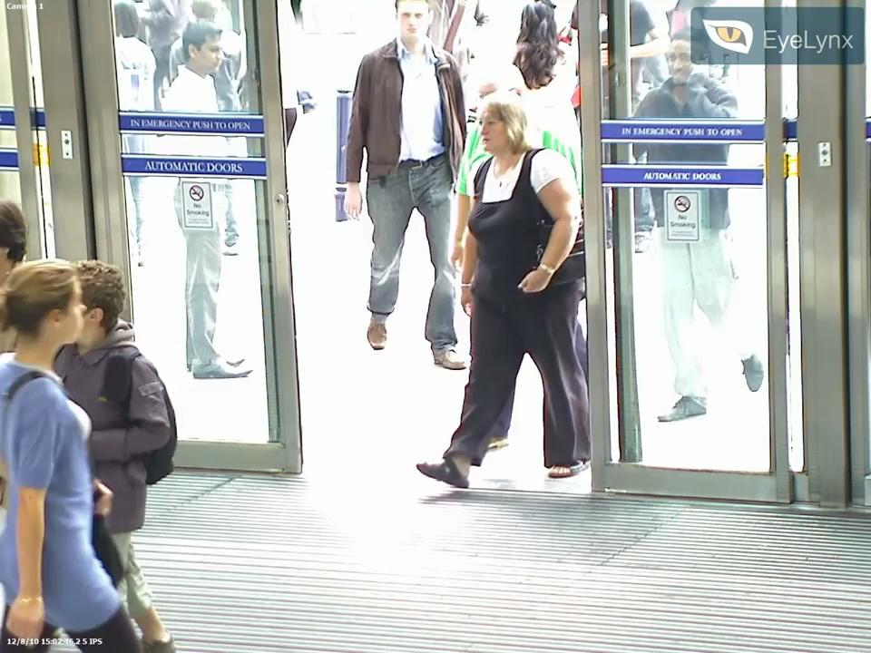
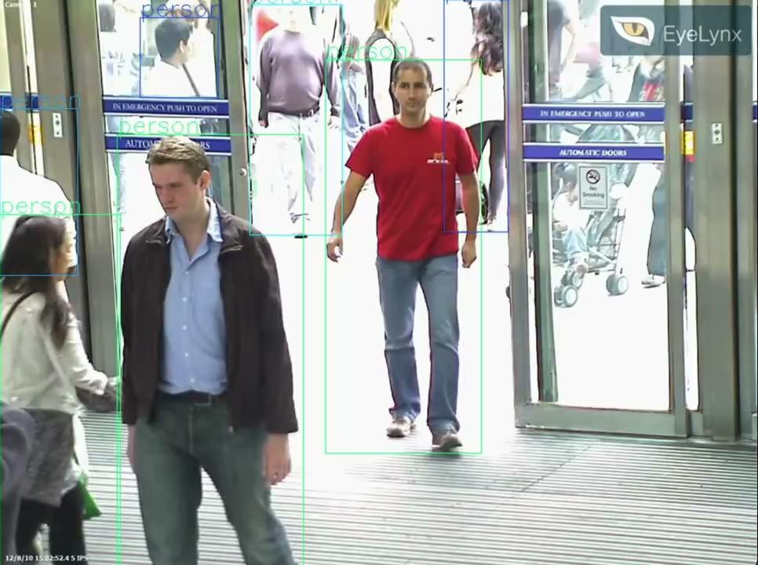
Object detection with YoLo-v7
-old video
-new video with detected objects
-maybe some metric

Slide 4
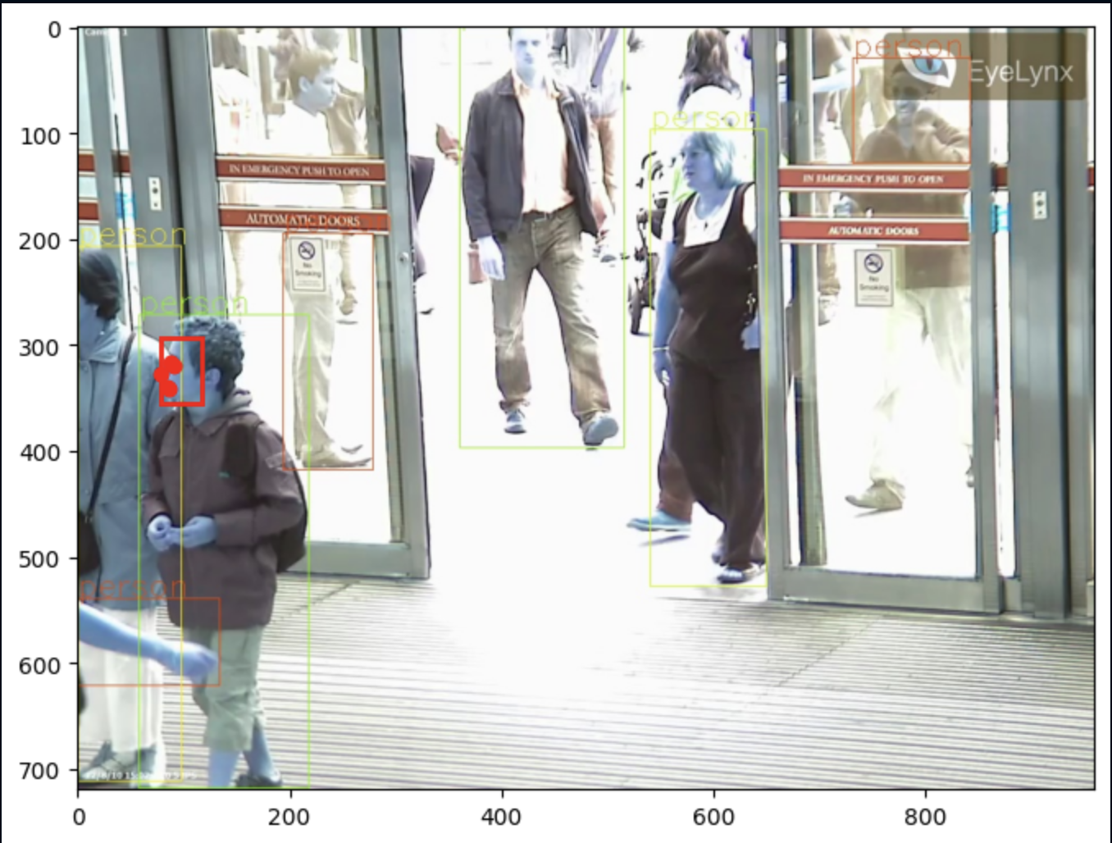
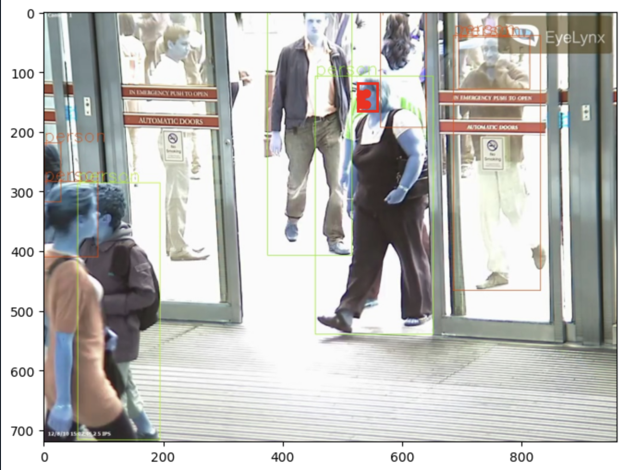
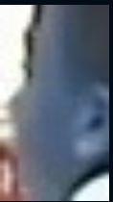
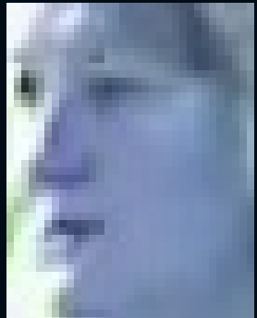
Face extraction using retinaface
one image of a frame with objects
extracted faces from the objects in the frame
one line on how it does that !
maybe metrics
point on detection of hard to detect faces

Slide 5
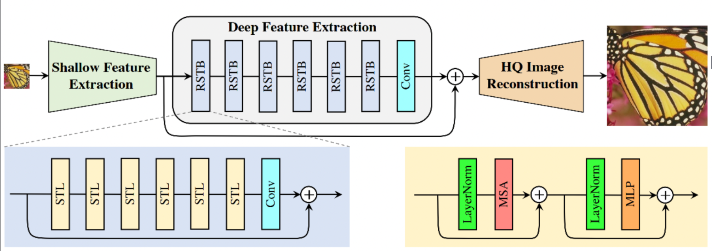
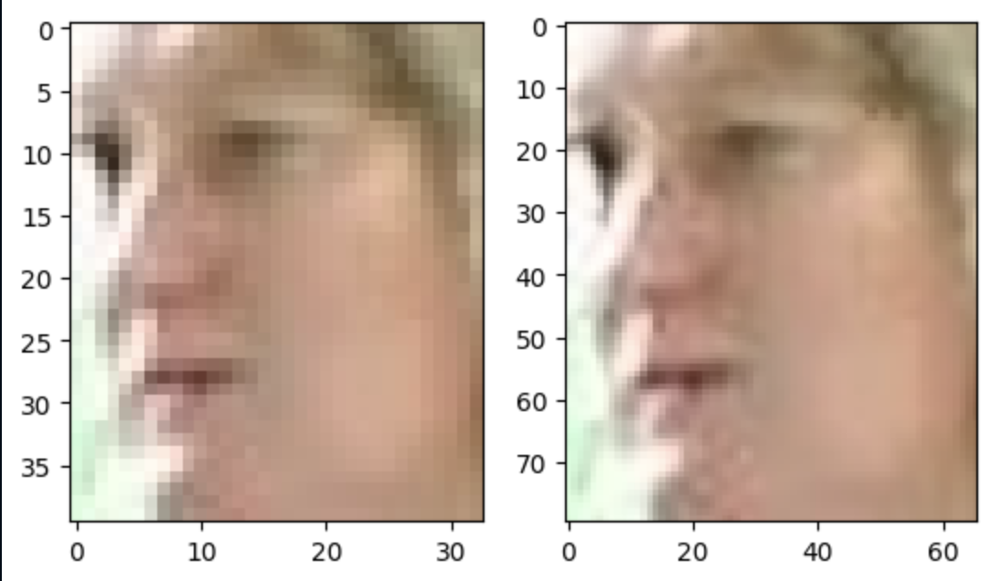
Face enhancement using SwinIR
Why is it needed?
Show one image side by side
maybe metrics

Slide 6
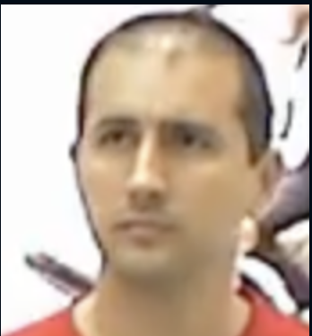
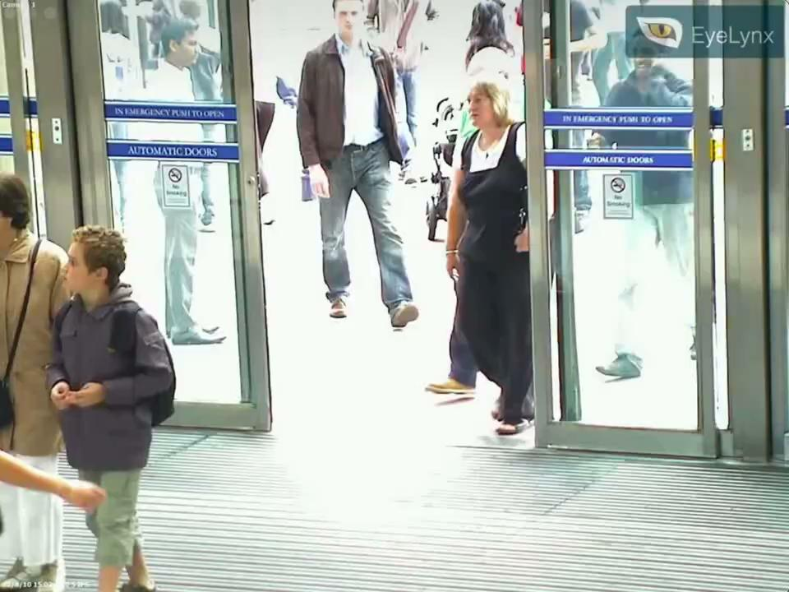
Face verification / matching using ArcFace
Explain, we have a target object/ person and want to track that person.
Show the main video and the output video
maybe metrics
maybe wrong detection also - in challenges

Slide 7
Improving SOTA target object tracking by Adversarial training
Proposal

Slide 8
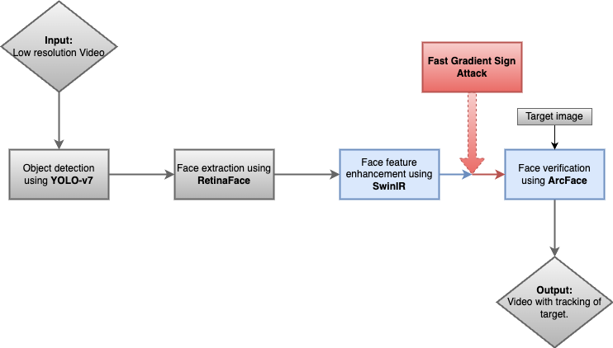
Attack Pipeline

Slide 9
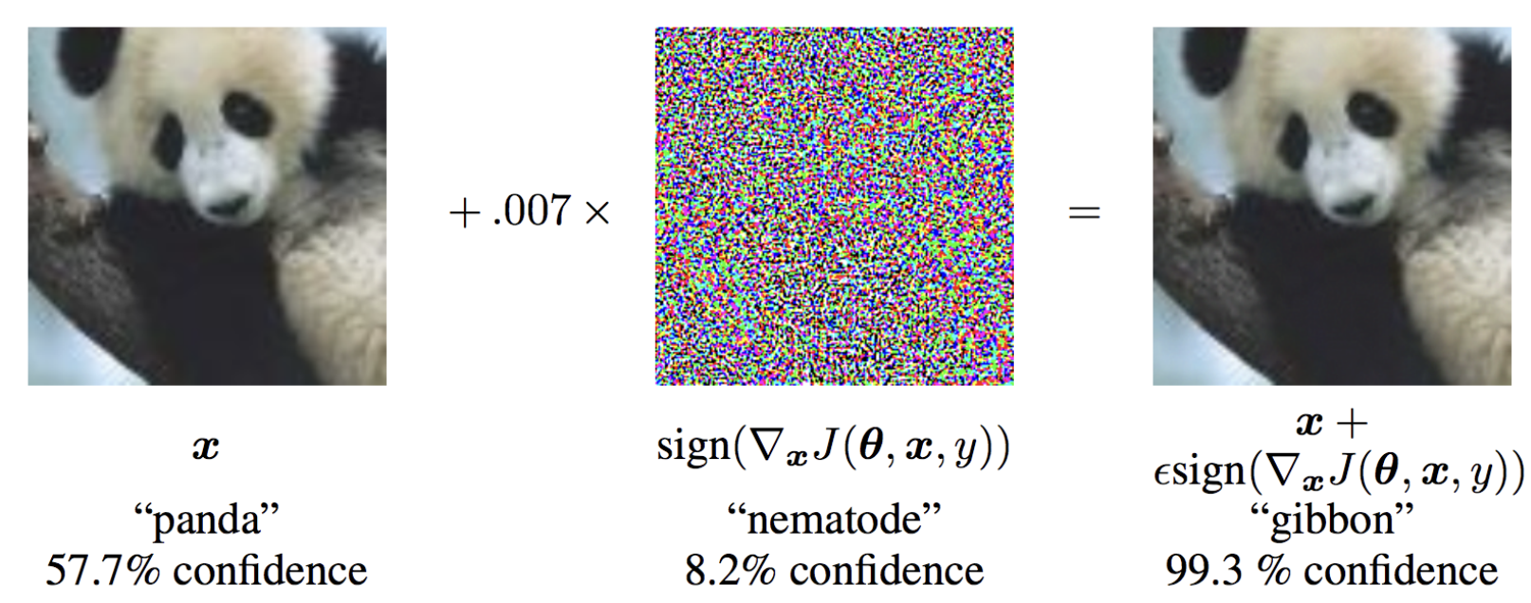
Fast gradient sign attack
input- epsilons, pretrained_model, use_cuda
output - perturbed_image
Goal: Add the least amount of perturbation to the input data to cause the desired misclassification.

Slide 10
Workflow
Using ART (a python library) to generate adversarial examples for the face verification model.
Training face verification model until it is able to correctly classify both clean and adversarial examples with high accuracy.

Slide 11
Experiments to be conducted
Data augmentation while training
Using cross-entropy with adversarial regularization (CEAR) as loss function

